Slide 1
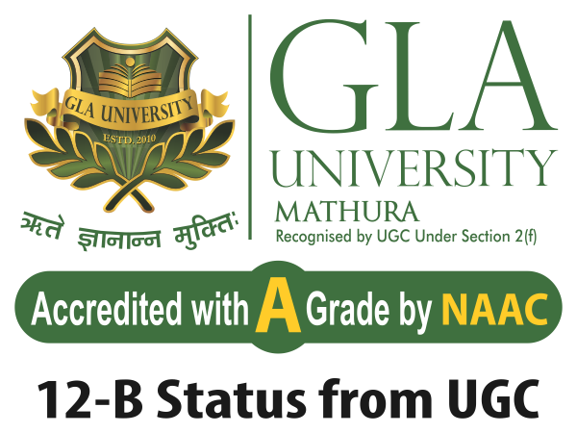
Recursive Methods and Problem solving

Slide 2
Index
Introduction to Recursion
Iterative Vs recursion
Head and tail recursion
Stack with recursion
Designing recursive algorithm

Slide 3
Calling Methods
Methods can call other methods
Can a method call itself?
Yes! This is called a recursive method (function)
“A method within a method”

Slide 4
Recursion
A method/procedure where the solution to a problem depends on solutions to smaller instances of the same problem
So we break the task into smaller subtasks
This approach can be applied to many types of problems and recursion is one of the central ideas of computer science
We have to define base cases in order to avoid infinite loops
We can solve problems with recursion or with iteration.

Slide 5
Add the first N numbers:
Usually we use a simple for/while loop but we can solve it with the help of recursive method call.
public void sum(int N)
{
Int smm =0;
for(int i =1;i<=N;i++)
{
sum=sum+i;
}
System.out.println(sum);
}
public int recursionSum(int N)
{
if(N==1) return 1; //base case
return N + recursionSum(N -1); // recursive call
}
ITERATION
RECURSION

Slide 6
Head Vs tail recursion
If the recursive call occurs at the end of a method -> It is called a tail recursion
The tail recursion is similar to a loop
The method executes all the statements before jumping into the next recursive call
If the recursive call occurs at the beginning of a method, it is called a head recursion.
The method saves the state before jumping into the net recursive call.

Slide 7
Head Vs tail recursion
public int tailRecursion(int N)
{
If ( N == 1) return //base case
System.out.println(N);
tailRecursion(N-1);
}
public int headRecursion(int N)
{
If ( N == 1) return //base case
headRecursion(N-1);// recursive call
System.out.println(N);
}

Slide 8
Stack with recursion
We have to track during recursion who called the given method and what arguments are to be handed over
AND WE HAVE TO TRACK THE PENDING CALLS !!!
We just need a single stack data structure: the operating system does everything for us by creating a run time stack.
These important information are to be pushed to the stack called stack frames/ Activation record
Values are popped from the stack

Slide 9
Stack with recursion
public int recursionSum(int N)
{
if(N==1) return 1; //base case
return N + recursionSum(N -1); // recursive call
}
BASE CASE
2 + recursionSum(1)
3 + recursionSum(2)
4 + recursionSum(3)

Slide 10
Stack with recursion
WHEN WE USED recursionSum(int N) method:
recursionSum(4)
recursionSum(3)
recursionSum(2)
recursionSum(1)
return 1
return 2+1
return 3+2+1
return 4+3+2+1
So these method calls like this and values are stored on the stack
Recursion is at least twice slower because first we unfold recursive calls(pushing them on a stack) until we reach the base case and then we traverse the stack and retrieve all recursive calls

Slide 11
Recursion or Iteration?
Moral: There is usually more than one way to solve a problem!
Iteration (loops to repeat code)
Recursion (nested function calls to repeat code)
Tradeoffs between two options:
Sometimes recursive solution is easier
Recursive solution is often slower

Slide 12
When to use Recursion / when to avoid recursion
When we easily breakdown a problem into smaller subproblem.
When we are ok with extra overhead (both time and space) that comes with it.
When we need a quick working solution instead of efficient one.

Slide 13
Facts about recursion
Recursive methods call themselves
Each call solves an identical problem
The code is the same!
Successive calls solve smaller/simpler instances
Every recursive algorithm has at least one base case
A known/easy to solve case
Often, when we reach 1 or 0

Slide 14
Designing Recursive Algorithm
General strategy: “Divide and Conquer”
Questions to ask yourself
How can we reduce the problem to smaller version of the same problem?
How does each call make the problem smaller?
What is the base case?
Will you always reach the base case?

Slide 15
References
Hyperskil Academy by jetbrains.
Chris Kiekintveld CS 2401 (Fall 2010) Elementary Data Structures and Algorithms

